Slide 1

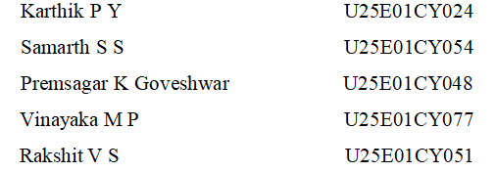
Sri Syala Educational Trust (R), Bheemasamudra G M UNIVERSITY, DAVANGERE School of Computer Science T Technology (SCST) DEPARTMENT OF CS-CYBER SECURITY & CS-INFORMATION SECURITY
A Project Synopsis Presentation on
“Password Strength Checker“
Presented By:
Uder Guidance of:
Ms. Madhu M C
Assistant Professor,
Dept. of CY & IY
Project Coordinator:
Dr. Rachana P G
Assistant Professor,
Dept. of CY & IY
Program Coordinator.
Dr. Aruna Kumar B T
Associate Professor &HOD,
Dept. of CY & IY

Slide 2





Photo
Madhu M C
Karthik P Y
Samarth S S
Premsagar K Goveshwar
Vinayaka M P
Rakshith V S

Slide 3

Contents
Introduction Problem Statement
Literature Survey Objectives
Requirements Flowchart
Methodology Outcomes/Future Scope
Dataset Conclusion
Reference

Slide 4
Introduction
Passwords are used to protect personal and sensitive information.
Weak passwords can be easily guessed or hacked.
Strong passwords improve the security of user accounts.
This project checks the strength of a password entered by the user.
It helps users create safer and more secure passwords.

Slide 5
Problem Statement
Many users create simple and weak passwords that are easy to guess or hack.
Weak passwords can lead to unauthorized access, data theft and security risks.
Therefore, a system is needed to check the strength of passwords and help users create more secure passwords.

Slide 6

Literature Survey
Sl No. | Title of the Paper | Author Name | Year of Published | Technology Adopted
1 | Password Strength Analysis using Machine Learning Based Techniques | Sakya Sarkar, Mauparna Nandan | 2022 | 1.Python 2.Machine Learning 3.Password Classification
2 | Machine Learning Based Password Strength Analysis | G. Krishna Teja, A. Harshel Srivatsava | 2022 | 1.ML Algorithms 2.Password Dataset Analysis 3.Classification Techniques
3 | Password Strength Analysis: A Survey | Krutarth Bhatt, Sandeep Kumar, and Prof. Saritha Murali | 2023 | 1.Rule-Based Password Checking 2. Survey-Based Analytical Study 3.Password Security Evaluation
4 | A Real-Time Password Strength Analyzer | Ravibalan, Vignesh and Raju | 2024 | 1.Real-Time Password Analysis 2.Rule-Based Validation 3.Password Complexity Evaluation

Slide 7
Objectives
To Design a system that evaluates the strength of user passwords.
It should analyze factors like length, complexity, and predictability to ensure security.
To Develop a Python-based application to analyze password strength. It should assess security by evaluating factors such as complexity, length, and common patterns.
To Implement security rules for evaluating passwords.
Ensure the rules enforce criteria such as length, complexity, and uniqueness.

Slide 8
Requirements
Hardware Requirements:
Computer / Laptop
Processor: Intel i3 or above
RAM: Minimum 4 GB
Keyboard and Mouse
Storage: Minimum 100 MB free space
2. Software Requirements:
Operating System: Windows 10 / 11
Programming Language: Python
IDE / Editor: PyCharm
Python Libraries: Built-in Python modules and Flask
Browser: Any web browser

Slide 9
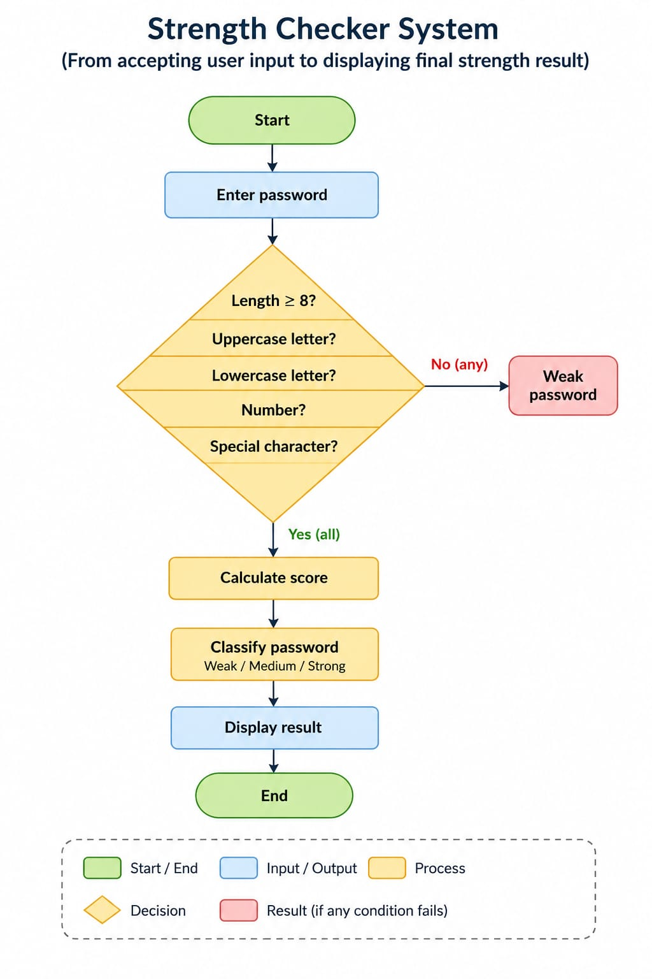
Flowchart
Flowchart of Password Strength Checker

Slide 10
Methodology
Requirement analysis
In this phase, the project requirements are identified and analyzed.
The system should accept a password from the user and check its strength based on security conditions
2.System design
In this phase, the overall structure and working of the system are planned.
The design includes:
User input section
Password checking logic
Strength result display (Weak / Medium / Strong)
Suggestion message for improving password security.

Slide 11
3. Front-end and Back-end development
In this phase, the project is implemented using Python.
Front-End:
User interface for entering password
Displaying password strength result
Back-End:
Python logic to check:
length
uppercase letters
lowercase letters
numbers
special characters
Classification of password as Weak, Medium, or Strong
The system is then tested using sample passwords.

Slide 12
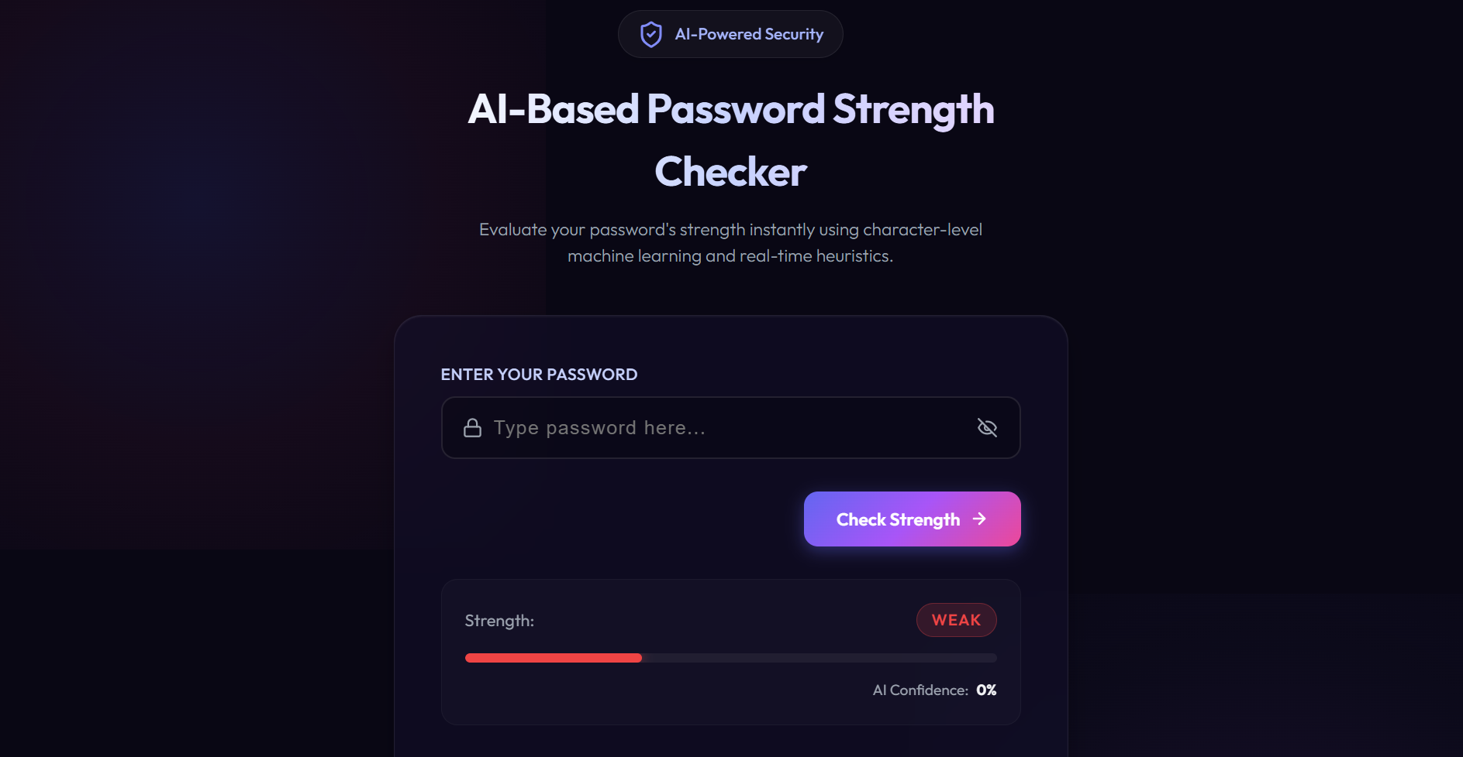
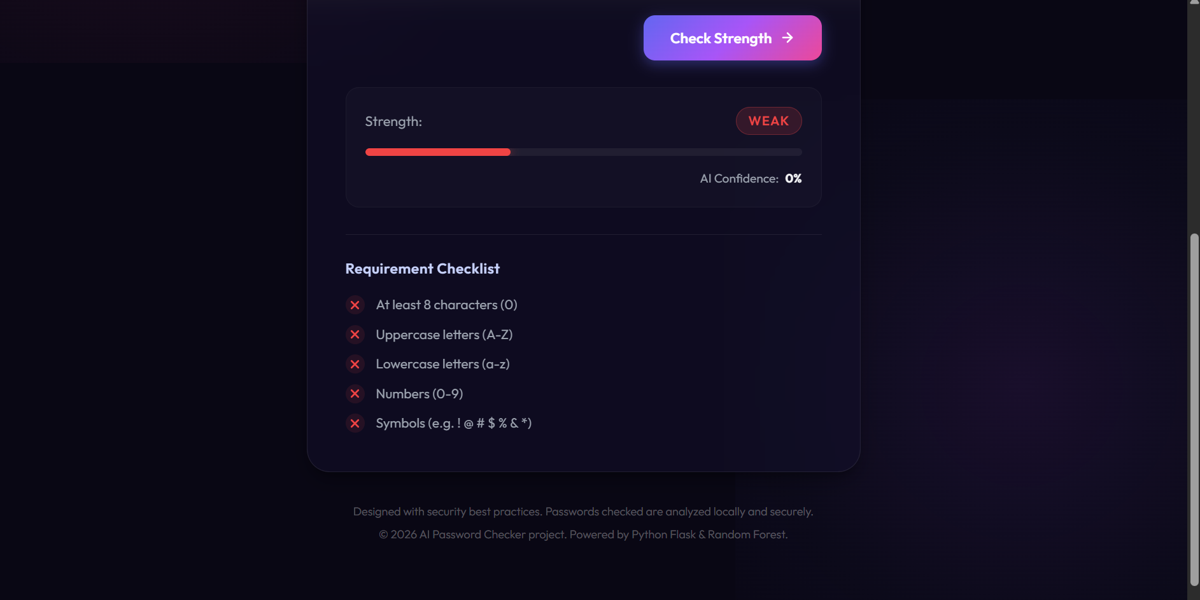
RESULT

Slide 13
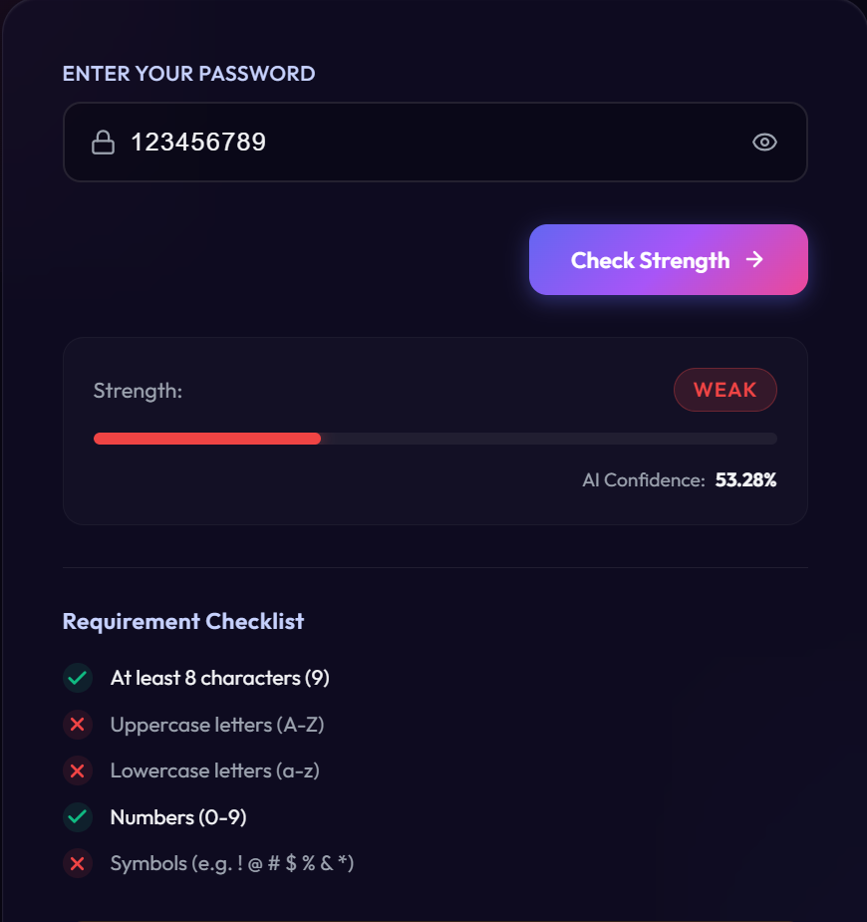
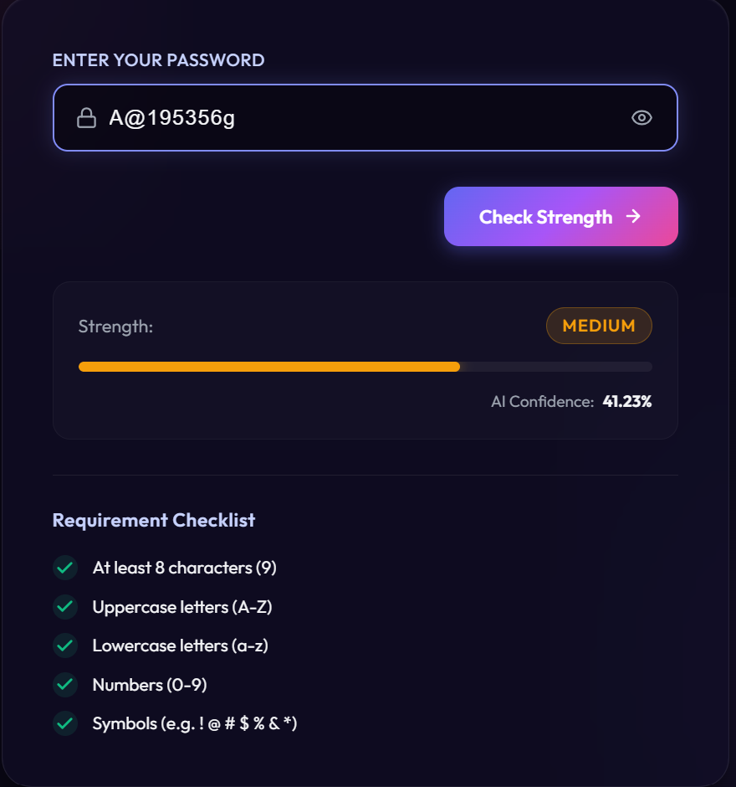

Slide 14
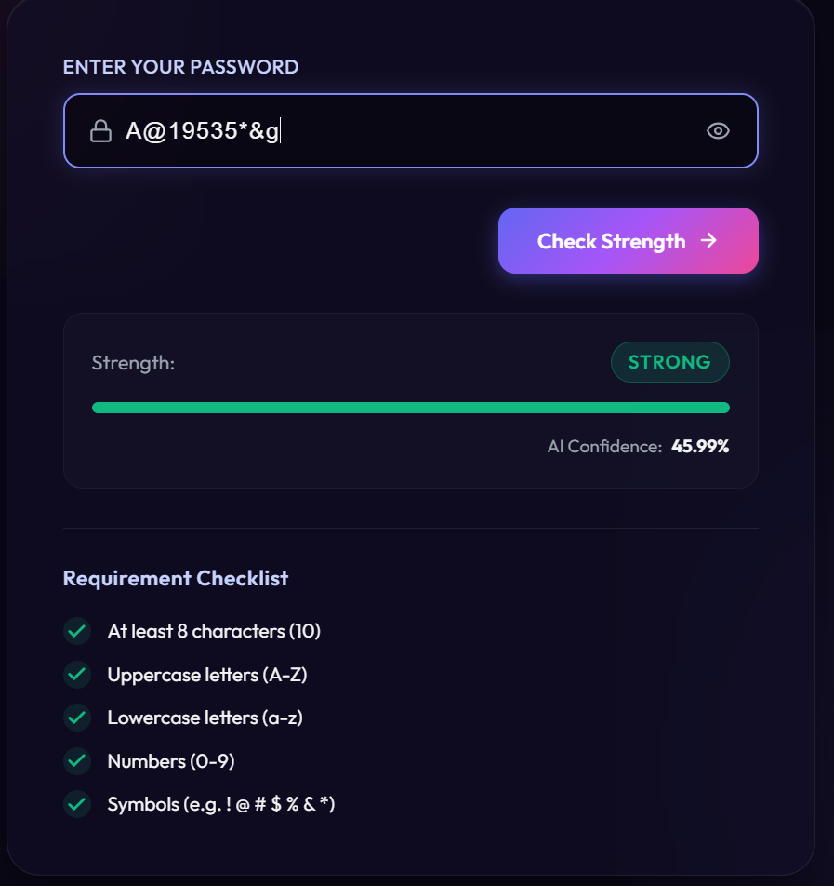

Slide 15
OUTCOMES/FUTURE SCOPE
Developed a web-based Password Strength Checker using HTML, CSS, JavaScript, and Python Flask.
Improved knowledge of Python programming and the Flask framework.
Created a user-friendly interface for easy password evaluation.
Learned how client-side and server-side components communicate.
Integrate with online databases of leaked passwords to warn users about breached passwords.
Add password history analysis to prevent password reuse.
Add detection of commonly used and compromised passwords.

Slide 16
Dataset/Coding
Password Dataset : Contains various passwords with labels such as Weak, Medium, and Strong based on password length, character combinations, and complexity.
Feature Dataset : Includes password features such as Length, Uppercase Letters Count, Lowercase Letters Count, Digits Count, Special Characters Count, and Entropy Score.
Training Dataset : Used to train the Machine Learning model to classify password strength accurately into Weak, Medium, or Strong categories.
Testing Dataset : Used to evaluate the performance and accuracy of the trained model on unseen password samples.

Slide 17
Conclusion
The Password Strength Checker will be developed using Python.
This project helps in checking whether a password is weak, medium, or strong based on important security conditions such as:
length of password
uppercase letters
lowercase letters
numbers
special characters
The project creates awareness about strong password usage and helps users improve their account security.

Slide 18
Reference
Sakya Sarkar and Mauparna Nandan,“Password Strength Analysis and its Classification by Applying Machine Learning Based Techniques” 2022.
Sony Kuriakose, G. Krishna Teja, A. Harshel Srivatsava, and Sravan Duggi,“Machine Learning Based Password Strength Analysis” 2022.
Sukrut Pendharkar, Krutarth Bhatt, Sandeep Kumar, and Prof. Saritha Murali,“Password Strength Analysis: A Survey” 2022.
Kalaivani, Ravibalan, Vignesh, Arockiya Aswin, and Raju,“A Real-Time Password Strength Analyzer” 2024.

Slide 19


Slide 20


